Slide 1
Chongqing University of Technology
ATAI
Advanced Technique of Artificial Intelligence
Chongqing University of Technology
BiTe-GCN: A New GCN Architecture via Bidirectional
Convolution of Topology and Features on Text-Rich Networks
(WSDM-2021)
Reported by Ling Zhu
Notes:
双向图卷积：一种新的图卷积框架用于富文本网络

Slide 2
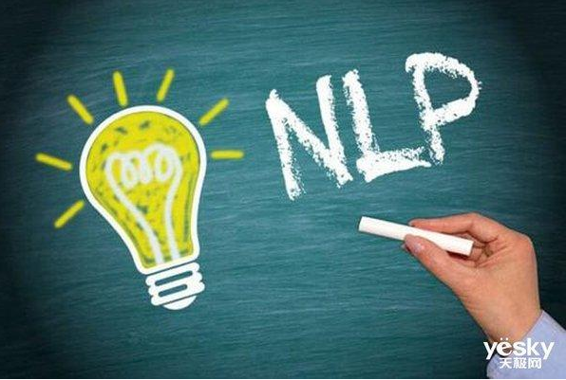
Chongqing University of Technology
ATAI
Advanced Technique of Artificial Intelligence
Chongqing University of Technology
1. Introduction
2. Motivation
3. Approach
4. Experiments
Notes:
http://www.360doc.com/content/21/0104/20/32196507_955195154.shtml
http://www.360doc.cn/mip/955195154.html

Slide 3
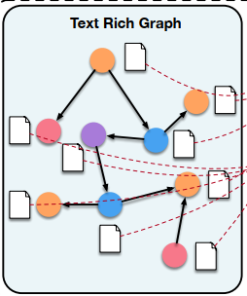
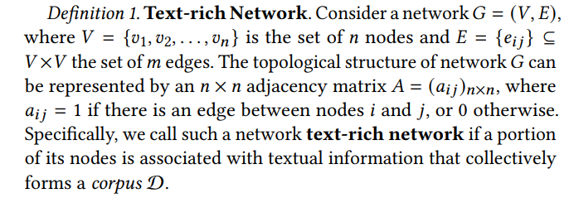
Introduction
Text-rich Network
Notes:
G=(V,E),V={}

Slide 4
Introduction
Current issue:
Existing GCNs rely heavily on the local homophily of topology, that is, neighborhoods should be similar, a very strong assumption in many real-world text-rich networks.
Existing methods ignore the local text information that reﬂects the semantics expressed in natural language.

Slide 5
Motivation
To solve these limitations, we propose BiTe-GCN, a novel GCN architecture modeling via bidirectional convolution of topology and features on text-rich networks.

Slide 6
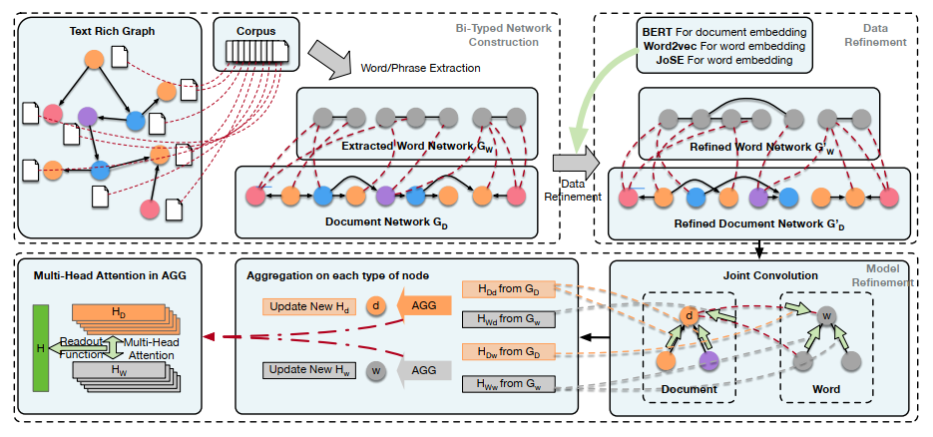
Approach

Slide 7
Approach
Bi-typed Network Construction
Word Network Construction
$T_{w}$=similarity(word_1, word_2),if $T_{w}>T_{whigh},add new edge,ifT_{w}<T_{wlow}$,delete edge
For example, “text_mining” and “data_mining” are connected since they share the word “mining”.
Whole Network Completion
$T_{D}={cosine(D}_{1}{,D}_{2})$,if $T_{D}>T_{dhigh},then add new edge between D_{1 }and D_{2},T_{D}<T_{dlow} delete this edge$
Notes:
http://chenhao.space/post/4d360cad.html#experiments
https://blog.csdn.net/qq_37262929/article/details/108602718
AutoPhrase

Slide 8
Approach
Joint Convolution
the same type of sub-network
diﬀerent types of sub-networks
Notes:
http://chenhao.space/post/4d360cad.html#experiments
https://blog.csdn.net/qq_37262929/article/details/108602718

Slide 9
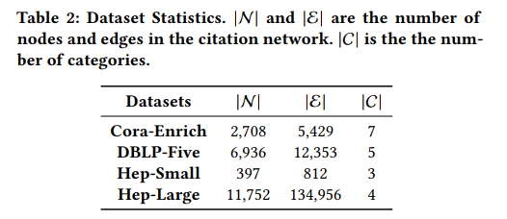
Experiments

Slide 10
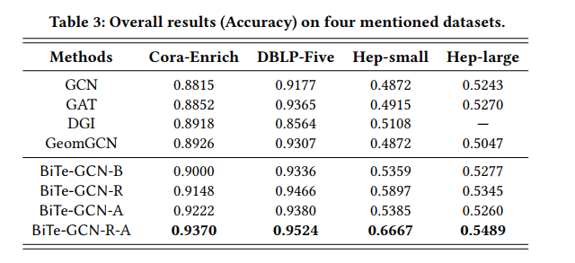
Experiments

Slide 11
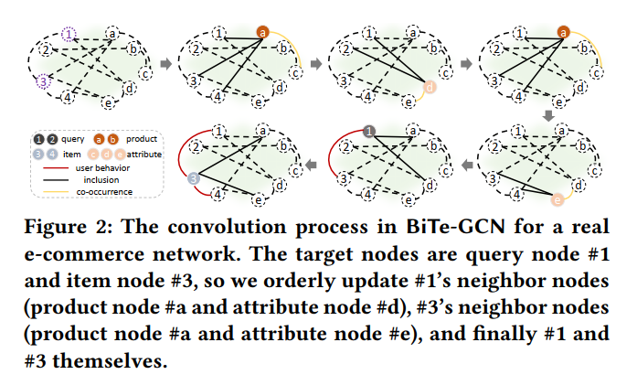
Experiments

Slide 12
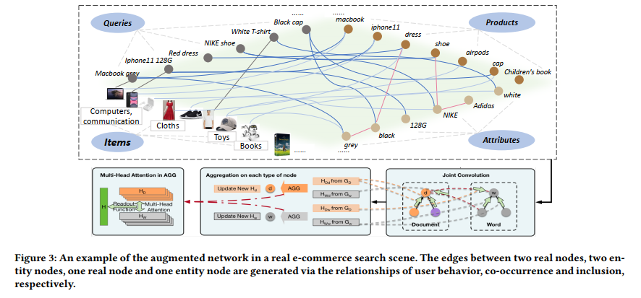
Experiments

Slide 13
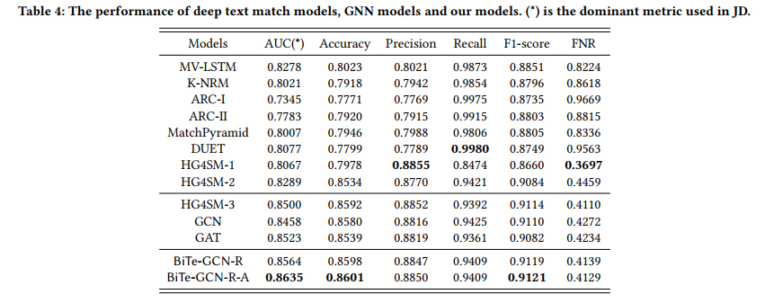
Experiments

Slide 14
Thanks

